Slide 1
Connecting to Legacy Systems,
IoT and other Systems

Slide 2
Implementation Specific @context
Reuse common data models and ontologies
Add use-case specific mappings where necessary
Remember to map all entities types, attributes and metadata attributes
Undefined terms will fallback to the default context https://uri.etsi.org/ngsi-ld/default-context
"fiware": "https://uri.fiware.org/ns/data-models#",
"schema": "https://schema.org/",
"example": "https://example.com/datamodels.html/",
"Building": "fiware:Building",
"Device": "fiware:Device",
"FillingLevelSensor": "example:FillingLevelSensor",
"CowCollar": "example:CowCollar",
"TemperatureSensor": "example:TemperatureSensor",
"Tractor": "example:Tractor",
… etc
"accuracy": "fiware:accuracy",
"batteryLevel": "fiware:batteryLevel",
"category": "fiware:category",
"controlledAsset": "fiware:controlledAsset",
"controlledProperty": "fiware:controlledProperty",
"deviceState": "fiware:deviceState",
"ipAddress": "fiware:ipAddress",
"macAddress": "fiware:macAddress",
"mcc": "fiware:mcc",
"osVersion": "fiware:osVersion",
"actuator": "https://w3id.org/saref#actuator",
"filling": "https://w3id.org/saref#fillingLevel",
"temperature": "https://w3id.org/saref#temperature",
"sensor": "https://w3id.org/saref#sensor",
"status": "https://saref.etsi.org/core/status",
"state": "https://saref.etsi.org/core/hasState",
"heartRate": "https://purl.bioontology.org/ontology/MESH/D006339",
… etc
"myCustomAttr": "example:mycustomAttr",
"secondCustomAttr": "example:2ndCustomAttr"

Slide 3
Configuring an IoT Agent as NGSI-LD
iot-agent:
image: fiware/iotagent-ul:latest
hostname: iot-agent
container_name: fiware-iot-agent
networks:
- default
expose:
- "4041"
- "7896"
ports:
- "4041:4041"
- "7896:7896"
environment:
- IOTA_CB_HOST=orion
- IOTA_CB_PORT=1026
- IOTA_NORTH_PORT=4041
- IOTA_REGISTRY_TYPE=mongodb
- IOTA_TIMESTAMP=true
- IOTA_AUTOCAST=true
- IOTA_MONGO_HOST=mongo-db
- IOTA_MONGO_PORT=27017
- IOTA_MONGO_DB=iotagentul
- IOTA_HTTP_PORT=7896
- IOTA_PROVIDER_URL=http://iot-agent:4041
- IOTA_CB_NGSI_VERSION=ld
- IOTA_FALLBACK_TENANT=openiot
- IOTA_JSON_LD_CONTEXT= http://../path/to/ngsi-context.jsonld
Configure using ENV or config.js
Essentials
IOTA_CB_NGSI_VERSION must be LD
IOTA_JSON_LD_CONTEXT must point to a
hosted file
Useful
IOTA_FALLBACK_TENANT if actuations
are required
IOTA_TIMESTAMP
IOTA_AUTOCAST

Slide 4
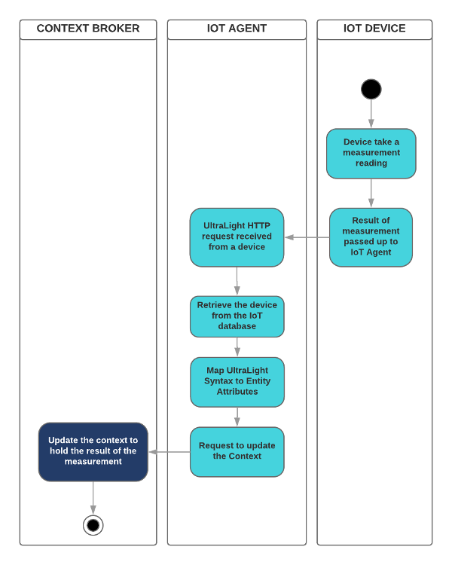
NGSI-LD Measures
The IoT Device is using a known payload syntax
Ultralight, JSON, SigFox, OPC-UA etc.
The IoT Device sends a reading using the agreed
protocol
HTTP, MQTT, AMPQ, LoRaWAN etc.
The IoT Agent interprets the payload and
transforms the measure into NGSI-LD
The only interface to the Context Broker is a
simple structured upsert of entities
potentially including linked entities

Slide 5
Measure: “Device X in Building Y has registered 25°C”
curl -L -X POST 'http://localhost:1026/ngsi-ld/v1/entityOperations/upsert' \
-H 'Content-Type: application/ld+json' \
-d '[
{
"@context": "http://example.com/context.json-ld",
"id": "urn:ngsi-ld:Device:thermometer1",
"type": "Device"
"temperature": {
"type": "Property",
"value": 25,
“observedAt": "2015-08-05T07:35:01.468Z",
"unitCode": "CEL",
"accuracy":{
"type": "Property", "value": 0.95,
"unitCode": "C62"
}
},
"controlledAsset": {
"type": "Relationship",
"object": "urn:ngsi-ld:Building:building1"
}
}
]'

Slide 6
Provisioning an NGSI-LD Service Group
curl -s -o /dev/null -X POST \
'http://iot-agent:4041/iot/services' \
-H 'Content-Type: application/json' -H 'fiware-service: openiot' \
-d '{
"services": [
{
"apikey": "321701236",
"cbroker": "http://orion:1026",
"entity_type": "Device",
"resource": "/iot/d",
"protocol": "PDI-IoTA-UltraLight",
"transport": "HTTP",
"timezone": "Europe/Berlin",
"attributes": [
{ "object_id": "t", "name":"temperature", "type": "Float",
"metadata": {"unitCode": {"type": "Property","value": "CEL"}}
}
],
"static_attributes": [
{"name": "description",
"type":"Property", "value": "Thermometer"},
{"name": "category", "type":"Property", "value": ["sensor"]},
{"name": "controlledProperty",
"type": "Property", "value": "temperature"},
{"name": "supportedProtocol",
"type": "Property", "value": ["ul20"]}
]
}
]
}'
/iot/services endpoint defines
common elements across groups
of devices
entity_type, attributes and
static_attributes correspond
to a data model found within
the @context file
attributes and static_attributes
may have associated metadata.
types should be defined as:
Property
Relationship
A native JSON type
A GeoJSON type

Slide 7
Provisioning NGSI-LD device
curl -s -o /dev/null -X POST \
'http://iot-agent:4041/iot/devices' \
-H 'Content-Type: application/json' \
-H 'fiware-service: openiot' \
-H 'fiware-servicepath: /' \
-d '{
"devices": [
{
"device_id": "txhme001xxe",
"entity_name": "urn:ngsi-ld:Device:temperature001",
"entity_type": "Device",
"static_attributes": [
{
"name": "controlledAsset",
"type": "Relationship",
"value": "urn:ngsi-ld:Building:001",
"link": {
"attributes": ["temperature"],
"name": "providedBy",
"type": "Building"
}
}
]
}
]
/iot/devices endpoint defines
additional data for an individual device
attributes and static_attributes
can also be defined at the device level
- the standard rules about types apply
Use link on a static_attribute to
update a linked Entity

Slide 8
GPS Measure: “GPS X has moved to location x,y”
With location payloads such as:
As Ultralight String
gps|13.3501,52.5143
As Ultralight Multiple attributes
lng|13.3501|lat|52.5143
JSON as string value:
{"gps": "13.3501,52.5143"}
JSON as array value:
{"gps": [13.3501, 52.5143]}
JSON as GeoJSON:
{
"gps": {
"type": "Point",
"coordinates": [13.3501, 52.5143]
}
}
etc...
Context Broker receives an NGSI-LD upsert
curl -L -X POST 'http://localhost:1026/ngsi-ld/v1/entityOperations/upsert' \
-H 'Content-Type: application/ld+json' \
-d '[
{
"@context": "http://example.com/context.json-ld",
"id": "urn:ngsi-ld:Device:gps1",
"type": "Device"
"location": {
"type": "GeoProperty",
"value": :{
"type": "Point",
"coordinates": [13.3501, 52.5143]
},
“observedAt": "2015-08-05T07:35:01.468Z"
},
"controlledAsset": {
"type": "Relationship",
"object": "urn:ngsi-ld:Tractor:tractor1"
}
}
]'

Slide 9
Provisioning GPS Devices
IoT Agent Device Provisioning
GPS Provisioning from a single input
Use location as the name of a geolocation attribute
Set type=GeoProperty or any GeoJSON type
Map an attribute object_id to NGSI-LD attribute name
Aliasing Latitude and Longitude as separate inputs
Use location as the name of a geolocation attribute
Set type=GeoProperty or any GeoJSON type
Use expression aliasing to map multiple inputs to a String
Remember GeoJSON uses Lng/Lan format
Will only fire if both latitude and longitude are present in
the payload
All GeoProperty input values are automatically converted into GeoJSON in the NGSI-LD upsert
{
"object_id": "gps",
"name":"location",
"type": "geo:point"
}
{
"name": "location",
"type": "geo:json",
"expression": "${@lng}, ${@lat}"
}

Slide 10
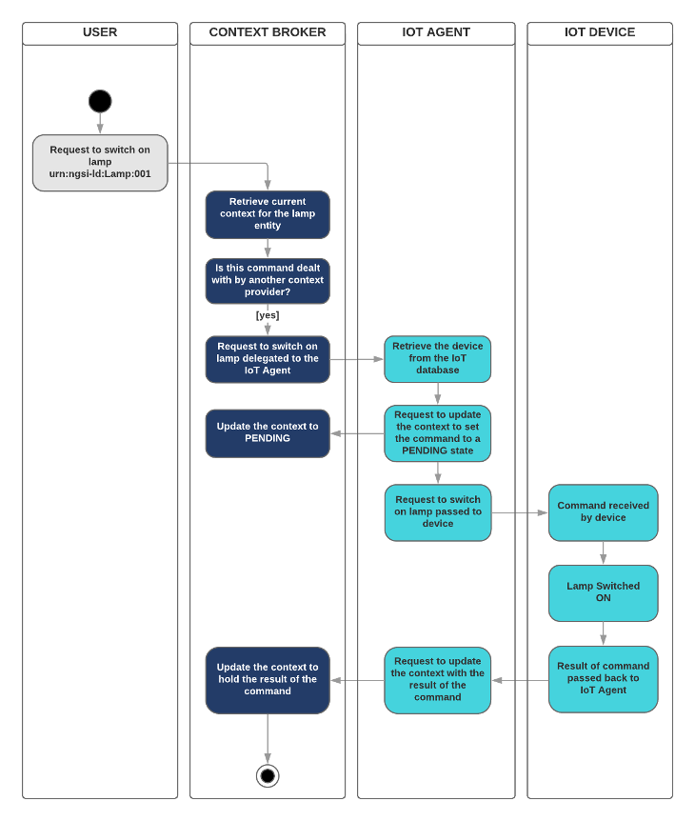
NGSI-LD Actuations
NGSI-LD actuation code is currently based on
the existing NGSI-v2 IoT Agent paradigm.
Uses registrations and request forwarding
Alternatively uses subscriptions and
notification payloads
Both mechanisms supported by IoT Agents.
Internally syntax may change based on the
decisions of the ETSI committee, but since
the listening mechanism is internal to the
IoT Agent library it will be updated once the
proposed interface is finalized.

Slide 11
Command provisioning - via actuation registration:
“I am responsible for Attribute X”
IoT Agent Device Provisioning
Context Broker receives a Registration
curl -L -X POST 'http://localhost:4041/iot/devices' \
-H 'fiware-service: openiot' \
-H 'Content-Type: application/json' \
--data-raw '{
"devices": [
{
"device_id": "water001",
"protocol": "PDI-IoTA-UltraLight",
"transport": "HTTP",
"endpoint": "http://device:3001/iot/water001",
"entity_name": "urn:ngsi-ld:Device:water001",
"entity_type": "Device",
"commands": [
{
"name": "on",
"type": "command"
},
{
"name": "off",
"type": "command"
}
]
}
]
}'
curl -L -X POST 'http://localhost:1026/ngsi-ld/v1/csourceRegistrations' \
-H 'NGSILD-Tenant: openiot' \
-H 'Content-Type: application/ld+json' \
-d '{
"@context": "http://context.json-ld",
"endpoint": "http://iotagent.com",
"information": [
{
"entities": [
{
"id": "urn:ngsi-ld:Device:water001",
"type": "Device"
}
],
"properties": [
"on",
"off"
]
}
],
"type": "ContextSourceRegistration"
}
'

Slide 12
Bidirectional attribute provisioning - actuation via subscription:
“Tell me when Attribute X changes”
Context Broker sends a Subscription
curl -L -X POST 'http://localhost:4041/iot/devices' \
-H 'fiware-service: openiot' \
-H 'fiware-servicepath: /' \
-H 'Content-Type: application/json' \
--data-raw '{
"devices": [
{
"device_id": "bell002",
"entity_name": "urn:ngsi-ld:Bell:002",
"entity_type": "Bell",
"protocol": "PDI-IoTA-UltraLight",
"transport": "HTTP",
"endpoint": "http://device:3001/iot/bell002",
"attributes": [
{ "name":"ring", "type":"Text",
"expression": "${@ring}",
"reverse": [
{
"object_id":"r", "type": "Text",
"expression": "${@ring}"
}
]
}
]
}
]
}'
{
"id": "urn:ngsi-ld:Notification:5fd0fa684eb81930c97005f3",
"type": "Notification",
"subscriptionId": "urn:ngsi-ld:Subscription:12345",
"notifiedAt": "2020-12-09T16:25:12.193Z",
"data": [
{
"id": "urn:ngsi-ld:Bell:002",
"type": "Bell",
"filling": {
"type": "Property",
"value": “ “,
}
}
]
}

Slide 13
Extending to legacy Systems via Upsert
Multiple options exist to architect this:
Amend legacy processing component to use NGSI directly as well as legacy protocol
Upload a file as CSV via an Agent? https://www.youtube.com/watch?v=HuEwI8wJKFU
Create a separate chron-job to query legacy system and upsert as NGSI?
Also consider using a database as an intermediary.
https://www.youtube.com/watch?v=_uLZDGFPlRA
function upsertToMongoDB(building) {
return new Promise((resolve, reject) => {
mongoDB
.upsert(
building.id, building.name,
building.address, building.verified)
.then(() => {
return resolve();
})
.catch((error) => {
return reject(error);
});
});
}
function duplicateBuildings(req, res) {
async function copyEntityData(building) {
await upsertToMongoDB(building);
}
req.body.data.forEach(copyEntityData);
res.status(204).send();
}

Slide 14
Extending to legacy Systems via Registration
“Tell me about X”, “I want to update X”
curl -L -X GET 'http://my-legacy-system/ngsi-ld/v1/entities/urn:ngsi-ld:Building:store001?attrs=tweets' \
-H 'Link: <https://my-context/context.jsonld>; rel="http://www.w3.org/ns/json-ld#context"; type="application/ld+json"' \
-H 'Content-Type: application/ld+json'
curl -L -X PATCH 'http://my-legacy-system/ngsi-ld/v1/entities/urn:ngsi-ld:Building:store001/attrs/tweets' \
-H 'Link: <https://my-context/context.jsonld>; rel="http://www.w3.org/ns/json-ld#context"; type="application/ld+json"' \
-H 'Content-Type: application/json' \
--data-raw '{
"type": "Property",
"value": [
"This must be Thursday",
"I never could get the hang of Thursdays."
]
} '
router.get('/ngsi-ld/v1/entities/:id',
NGSIProxy.getAsNgsiLD
);
router.patch(
'/ngsi-ld/v1/entities/:id/attrs',
NGSIProxy.updateEntity
);
function getAsNgsiLD(req, res) {
const response = doSomething(req);
if (req.headers.accept === 'application/json') {
res.set('Content-Type', 'application/json');
delete response['@context'];
} else {
res.set('Content-Type', 'application/ld+json');
}
res.send(response);
}

Slide 15
Extending to legacy Systems via Subscription
“Inform me about X so I can do something”
{
"id": "urn:ngsi-ld:Notification:5fd0fa684eb81930c97005f3",
"type": "Notification",
"subscriptionId": "urn:ngsi-ld:Subscription:12345",
"notifiedAt": "2020-12-09T16:25:12.193Z",
"data": [
{
"id": "urn:ngsi-ld:Bell:002",
"type": "Bell",
"filling": {
"type": "Property",
"value": “ “,
}
}
]
}
router.post('/subscription/:type', (req, res) => {
_.forEach(req.body.data, (item) => {
doSomething(req, item);
});
res.status(204).send();
});

Slide 16
Useful links
JSON-LD
Website: https://json-ld.org/
Linked Data Video: https://www.youtube.com/watch?v=vioCbTo3C-4
JSON-LD Video: https://www.youtube.com/watch?v=4x_xzT5eF5Q
NGSI-LD
ETSI Specification: https://www.etsi.org/deliver/etsi_gs/CIM/001_099/009/01.03.01_60/gs_cim009v010301p.pdf
NGSI-LD Video: https://www.youtube.com/watch?v=rZ13IyLpAtA
Tutorials: https://ngsi-ld-tutorials.readthedocs.io/
Smart Data Models
Website: http://smartdatamodels.org/
Smart Cities Data Models Video: https://www.youtube.com/watch?v=dfMo0HnaIUQ

